Slide 1
FIGURES

Slide 2
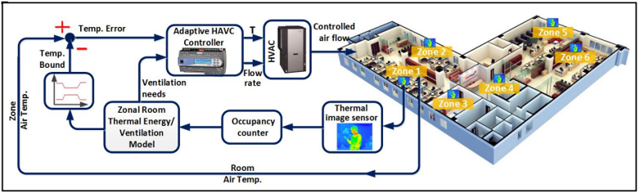

Slide 3
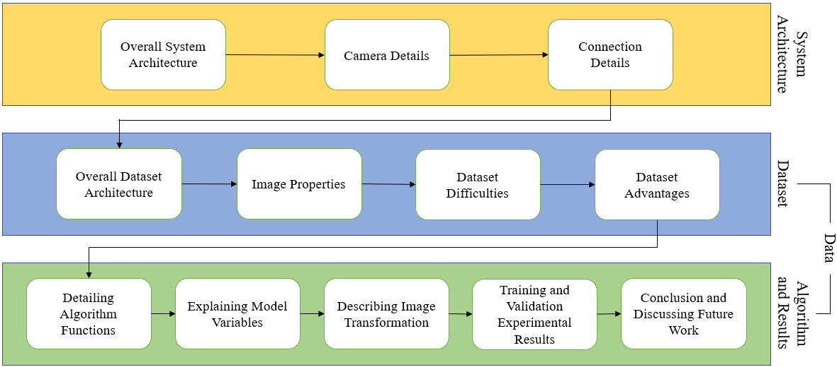

Slide 4
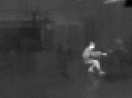

Slide 5
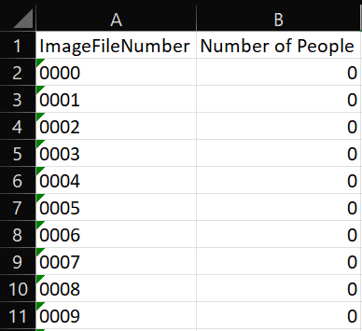

Slide 6


Training Ratio = $1−(\frac{1}{\sqrt{n}})$
Validation Ratio = $1/\sqrt{n}$

Slide 7
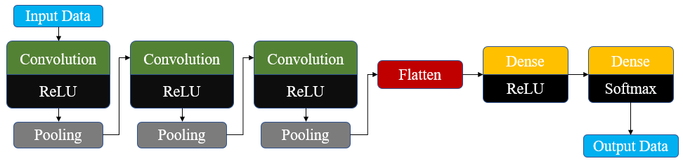

Slide 8
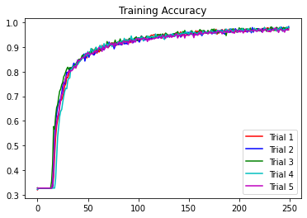
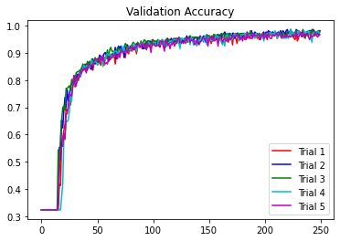
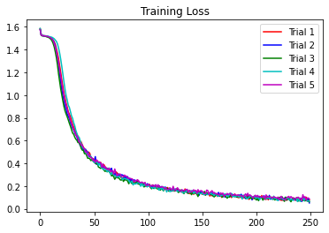
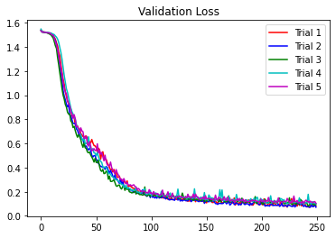

Slide 9
TABLES

Slide 10
Pin Type | Raspberry Pi 4 Pin Number | Breakout Board Pin Number
Ground | 6 | 1
3.3V Power | 1 | 2
SDA | 3 | 5
SCL | 5 | 8
MOSI | 19 | 9
MISO | 21 | 12
SCLK | 23 | 7
CS | 24 | 10

Slide 11
Type of Layer | Output Shape
2D Convolution | (None, 78, 58, 64)
2D Max Pooling | (None, 39, 29, 64)
2D Convolution | (None, 37, 27, 64)
2D Max Pooling | (None, 18, 13, 64)
2D Convolution | (None, 16, 11, 64)
2D Max Pooling | (None, 8, 5, 64)
Flatten | (None, 2560)
Dense | (None, 512)
Dense | (None, 5)

Slide 12
ANYTHING AFTER THIS POINT IS UNUSED

Slide 13
Machine Learning Model Architecture
Select CNN Type
Classify Images
Understand Variation in the Results
Investigate Errors and their Causes
Method
Image Labeling
Development of Code
Image Separation for Training and Testing
Composition
Data
Define Parameters
Train and Validate the Model
Analyze Accuracy and Loss
Evaluate Performance
Conclusion
Analysis

Slide 14
Overall System Architecture
Camera Details
Connection Details
System Architecture
Overall Dataset Architecture
Image Properties
Dataset Difficulties
Dataset Advantages
Dataset
Data
Detailing Algorithm Functions
Explaining Model Variables
Describing Image Transformation
Training and Validation Experimental Results
Conclusion and Discussing Future Work
Algorithm and Results

Slide 15
Input Data
Convolution
Convolution
Convolution
Dense
Dense
Flatten
ReLU
ReLU
ReLU
ReLU
Softmax
Pooling
Pooling
Pooling
Output Data

Slide 16
